Slide 1
EECS E6895 - Progress 2 A-share Stock Auto Trader
B9: Investment Strategy - AI Trader (CN/HK/TW/JP)
Yiwen Fang (yf2560) | Guoshiwen Han (gh2567)

Slide 2
Web Application
Model training
Experiments
Q & A

Slide 3
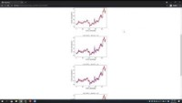
Web Application by Django Framework
Source: https://youtu.be/0MoqGz_pCF4

Slide 4
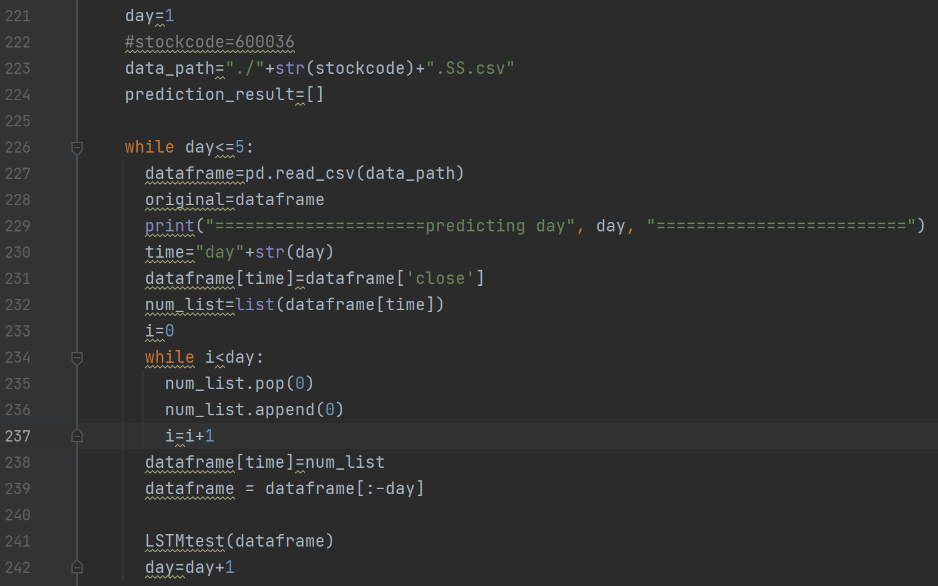
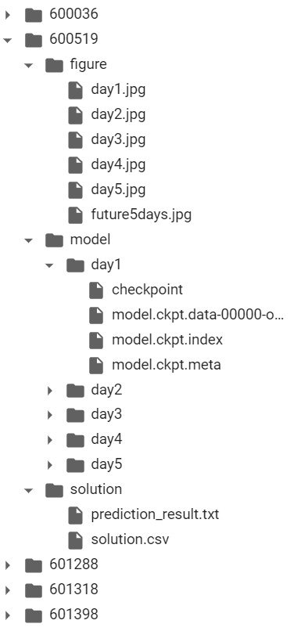
Model Training
According to input stock code, we will collect latest data of this stock and use the data to train LSTM model.
We train models for the next 5 days to predict the closing prices of the stock in the next 5 days.

Slide 5
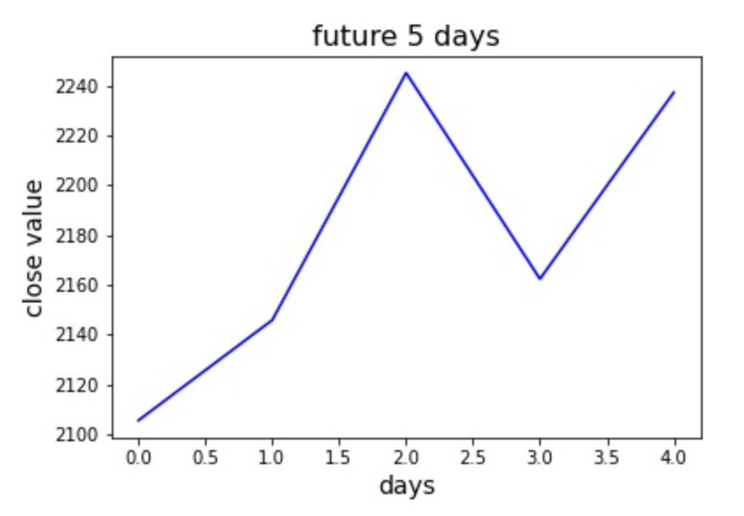
Model Training
Based on prediction result, we can get the tendency of next week, and we will be able to get a trading strategy according to it.
Compare to real value:

Slide 6
Model Training
We tried a longer period: 30 days, and then found that the trend looks more accurate, but because of the long training time, our trading strategy this time is still based on the 5-day forecast.

Slide 7
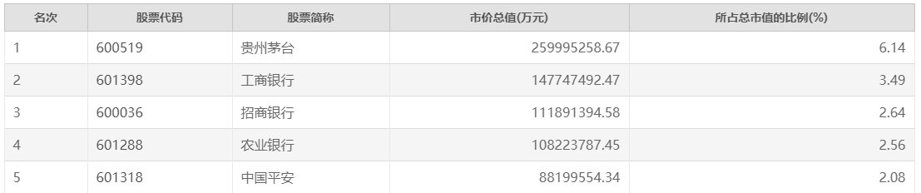
Experiment
We selected top 5 stocks by market capitalization to test our model.
Ranking
Stock code
Stock abbreviation
Total market value (ten thousand yuan)
Total market share (%)
According to our model, we give out trading operations that should be executed this week.
600519:
601288:
day1 | day2 | day3 | day4 | day5
2105.601 | 2145.876 | 2245.104 | 2162.372 | 2237.245
buy | hold | sell | buy | sell
day1 | day2 | day3 | day4 | day5
3.075491 | 3.022646 | 3.562933 | 3.529859 | 3.536449
hold | buy | sell | buy | sell
601398:
601318:
day1 | day2 | day3 | day4 | day5
5.378158 | 5.417605 | 5.439079 | 5.530206 | 5.373069
buy | hold | hold | sell | hold
day1 | day2 | day3 | day4 | day5
86.36325 | 83.28569 | 85.2497 | 87.23275 | 86.70916
hold | buy | hold | sell | hold
600036:
day1 | day2 | day3 | day4 | day5
53.55167 | 54.04567 | 54.48933 | 55.10054 | 55.49297
buy | hold | hold | hold | sell

Slide 8
Q & A

